Slide 1
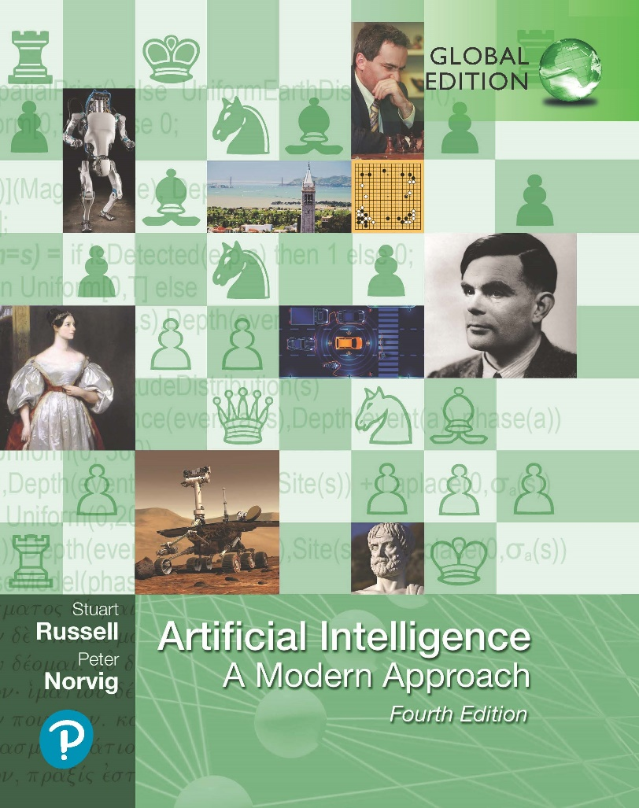
Artificial Intelligence: A Modern Approach
Fourth Edition, Global Edition
Chapter 2
Intelligent Agents

Slide 2
Outline
Agents and environments
Rationality
PEAS (Performance measure, Environment, Actuators, Sensors)
Environment types
Agent types

Slide 3
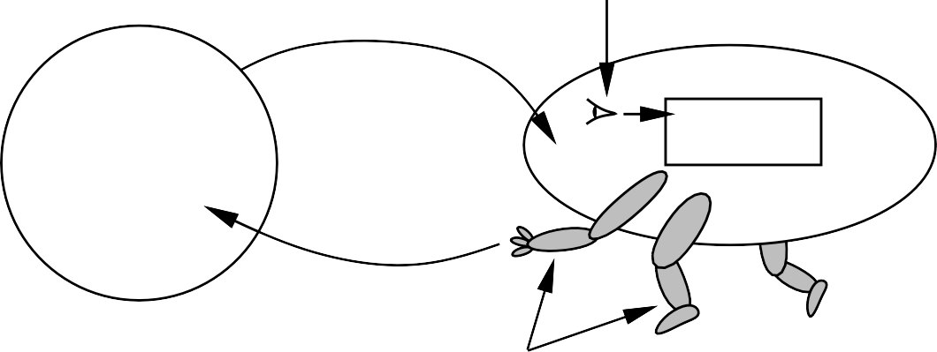
Agents and environments
sensors
percepts
?
agent
environment
actions
actuators
Agents include humans, robots, softbots, thermostats, etc.
An agent can be anything that can be viewed as perceiving its environment through sensors and acting upon that environment through actuators
The agent function maps from percept histories to actions:
f : P∗ → A
The agent program runs on the physical architecture to produce f

Slide 4







Vacuum-cleaner world
A B
Percepts: location and contents, e.g., [A, Dirty]
Actions: Left, Right, Suck, N oOp

Slide 5
A vacuum-cleaner agent
Percept sequence | Action
[A, Clean] | Right
[A, Dirty] | Suck
[B, Clean] | Left
[B, Dirty] | Suck
[A, Clean], [A, Clean] | Right
[A, Clean], [A, Dirty] | Suck
. | .
function Reflex-Vacuum-Agent( [location,status]) returns an action
if status = Dirty then return Suck else if location = A then return Right else if location = B then return Left
What is the right function?
Can it be implemented in a small agent program?

Slide 6
Rationality
Fixed performance measure evaluates the environment sequence
one point per square cleaned up in time T ?
one point per clean square per time step, minus one per move?
penalize for > k dirty squares?
A rational agent chooses whichever action maximizes the expected value of the performance measure given the percept sequence to date
Rational /= omniscient
percepts may not supply all relevant information Rational /= clairvoyant
action outcomes may not be as expected Hence, rational /= successful
Rational ⇒ exploration, learning, autonomy

Slide 7
PEAS
To design a rational agent, we must specify the task environment
Consider, e.g., the task of designing an automated taxi: Performance measure??
Environment?? Actuators??
Sensors??

Slide 8
PEAS
To design a rational agent, we must specify the task environment
Consider, e.g., the task of designing an automated taxi:
Performance measure?? safety, destination, profits, legality, comfort, . . .
Environment?? US streets/freeways, traffic, pedestrians, weather, . . .
Actuators?? steering, accelerator, brake, horn, speaker/display, . . .
Sensors?? video, accelerometers, gauges, engine sensors, keyboard, GPS, . . .

Slide 9
Internet shopping agent
Performance measure??
Environment?? Actuators??
Sensors??

Slide 10
Internet shopping agent
Performance measure?? price, quality, appropriateness, efficiency
Environment?? current and future WWW sites, vendors, shippers Actuators?? display to user, follow URL, fill in form
Sensors?? HTML pages (text, graphics, scripts)

Slide 11
Environment types
 | Solitaire Backgammon Internet shopping Taxi
Observable?? Deterministic?? Episodic?? Static?? Discrete?? Single-agent??

Slide 12
Environment types
 | Solitaire Backgammon Internet shopping Taxi
Observable?? Deterministic?? Episodic?? Static?? Discrete?? Single-agent?? | Yes Yes No No

Slide 13
Environment types
 | Solitaire Backgammon Internet shopping Taxi
Observable?? Deterministic?? Episodic?? Static?? Discrete?? Single-agent?? | Yes Yes No No Yes No Partly No

Slide 14
Environment types
 | Solitaire Backgammon Internet shopping Taxi
Observable?? Deterministic?? Episodic?? Static?? Discrete?? Single-agent?? | Yes Yes No No Yes No Partly No No No No No

Slide 15
Environment types
 | Solitaire Backgammon Internet shopping Taxi
Observable?? Deterministic?? Episodic?? Static?? Discrete?? Single-agent?? | Yes Yes No No Yes No Partly No No No No No Yes Semi Semi No

Slide 16
Environment types
 | Solitaire Backgammon Internet shopping Taxi
Observable?? Deterministic?? Episodic?? Static?? Discrete?? Single-agent?? | Yes Yes No No Yes No Partly No No No No No Yes Semi Semi No Yes Yes Yes No

Slide 17
Environment types
 | Solitaire Backgammon Internet shopping Taxi
Observable?? Deterministic?? Episodic?? Static?? Discrete?? Single-agent?? | Yes Yes No No Yes No Partly No No No No No Yes Semi Semi No Yes Yes Yes No Yes No Yes (except auctions) No
The environment type largely determines the agent design
The real world is (of course) partially observable, stochastic, sequential, dynamic, continuous, multi-agent

Slide 18
Agent types
Four basic types in order of increasing generality:
simple reflex agents
reflex agents with state
goal-based agents
utility-based agents
All these can be turned into learning agents

Slide 19
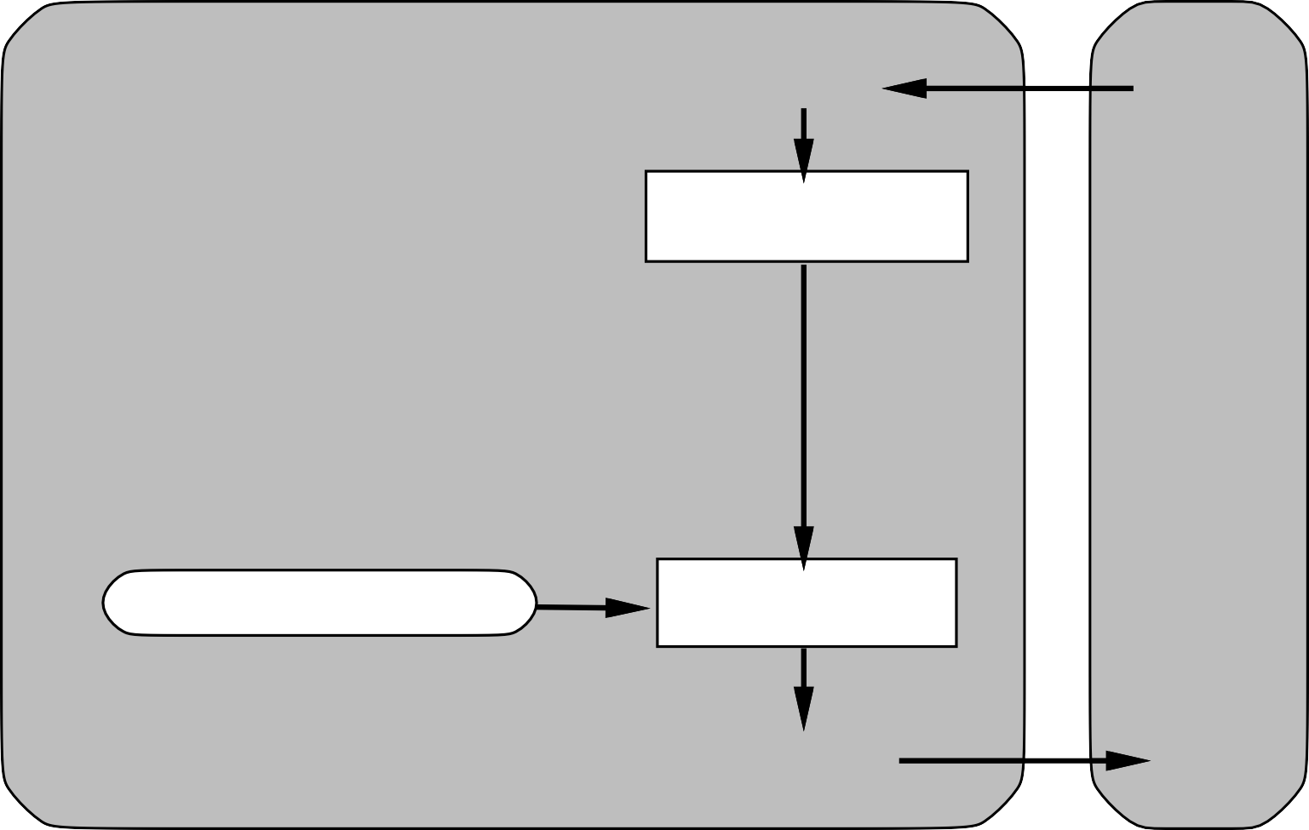
Simple reflex agents
Agent
Sensors
What the world is like now
Environment
Condition−action rules
What action I should do now
Actuators

Slide 20
Example
function Reflex-Vacuum-Agent( [location,status]) returns an action
if status = Dirty then return Suck else if location = A then return Right else if location = B then return Left
(setq joe (make-agent :name ’joe :body (make-agent-body)
:program (make-reflex-vacuum-agent-program))
(defun make-reflex-vacuum-agent-program () #’(lambda (percept)
(let ((location (first percept)) (status (second percept))) (cond ((eq status ’dirty) ’Suck)
((eq location ’A) ’Right) ((eq location ’B) ’Left)))))

Slide 21
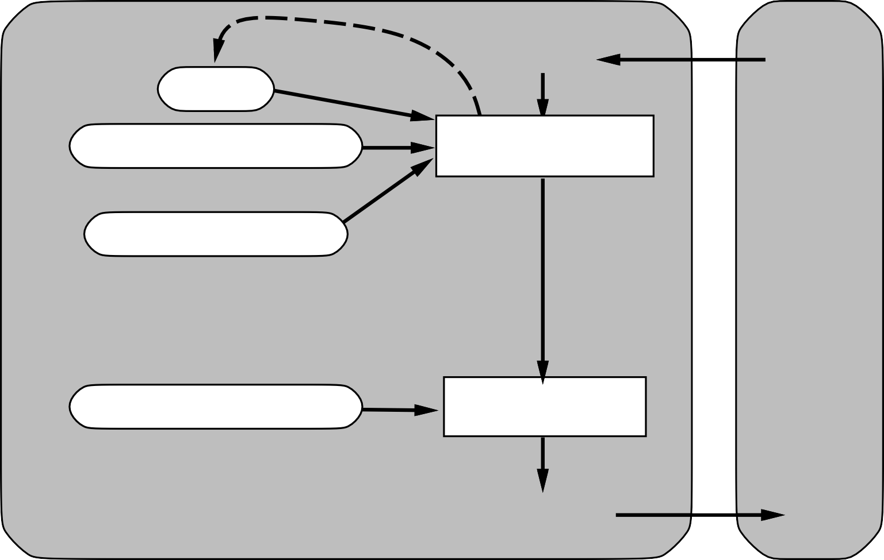
Reflex agents with state
Sensors
State
How the world evolves
What the world is like now
Environment
What my actions do
Condition−action rules
What action I should do now
Agent
Actuators

Slide 22
Example
function Reflex-Vacuum-Agent( [location,status]) returns an action
static: last A, last B, numbers, initially ∞
if status = Dirty then . . .
(defun make-reflex-vacuum-agent-with-state-program () (let ((last-A infinity) (last-B infinity)) #’(lambda (percept)
(let ((location (first percept)) (status (second percept))) (incf last-A) (incf last-B)
(cond
((eq status ’dirty)
(if (eq location ’A) (setq last-A 0) (setq last-B 0)) ’Suck)
((eq location ’A) | (if | (> last-B 3) | ’Right ’NoOp))
((eq location ’B) | (if | (> last-A 3) | ’Left ’NoOp)))))))

Slide 23

Model-based agents
Sensors
State
How the world evolves
What the world is like now
Environment
What my actions do
Goals
What action I should do now
Agent
Actuators

Slide 24
Goal-based agents
Sensors
State
How the world evolves
What the world is like now
Environment
What my actions do
What it will be like if I do action A
Goals
What action I should do now
Agent
Actuators

Slide 25

Utility-based agents
Sensors
State
How the world evolves
What the world is like now
Environment
What my actions do
What it will be like if I do action A
Utility
How happy I will be in such a state
What action I should do now
Agent
Actuators

Slide 26
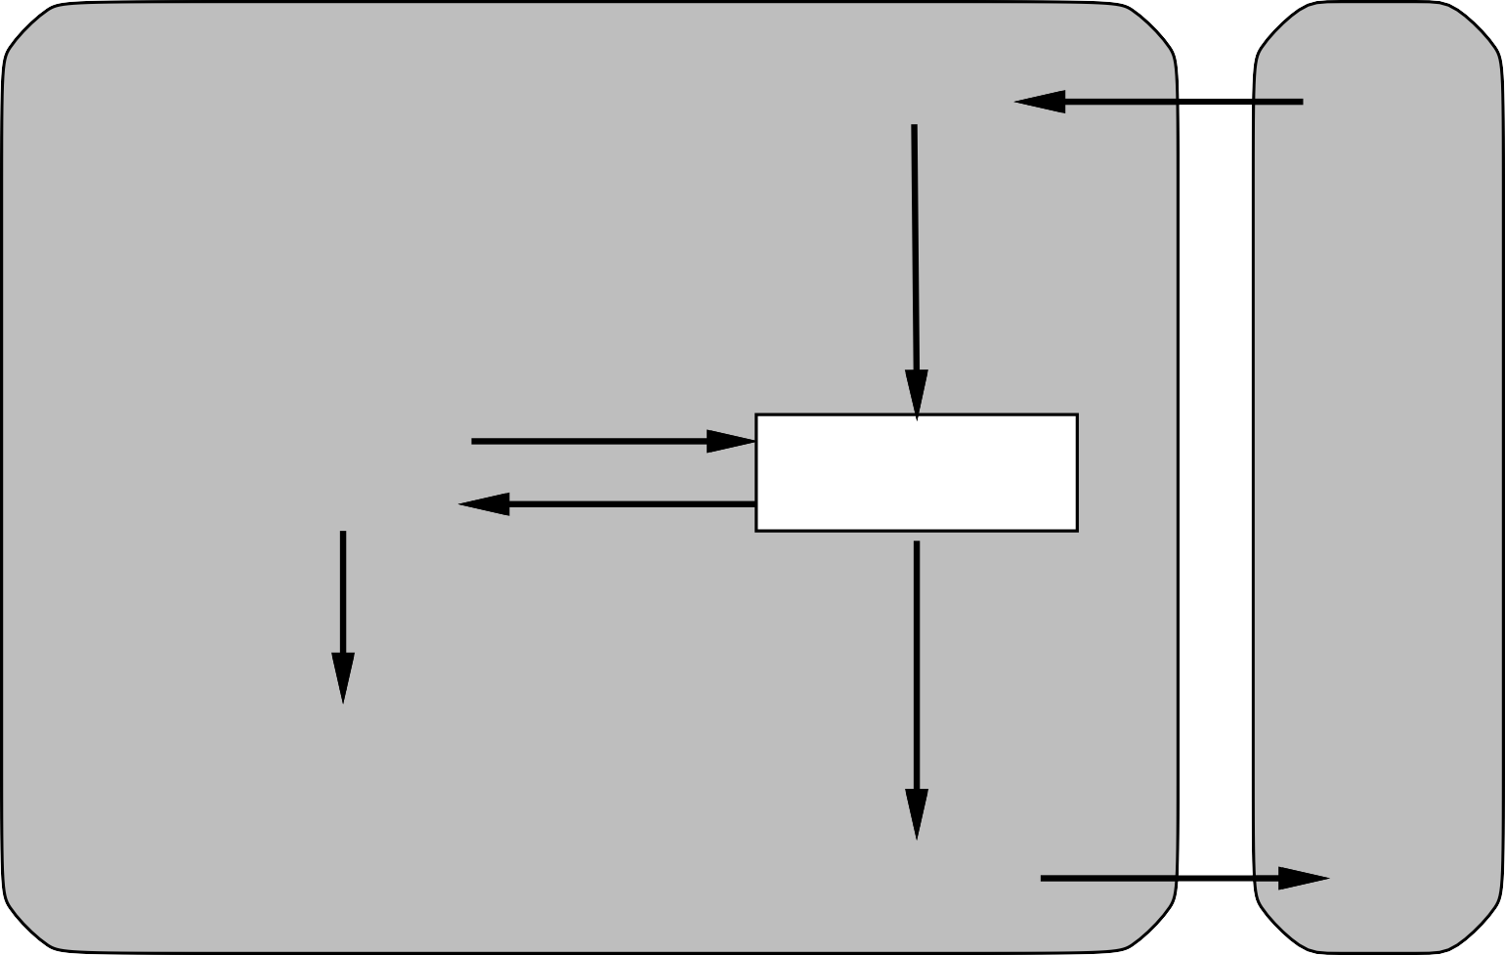
Learning agents
Performance standard
Critic
Sensors
feedback
changes
Environment
Learning element
Performance element
knowledge
learning goals
Problem generator
Agent
Actuators

Slide 27
Summary
Agents interact with environments through actuators and sensors
The agent function describes what the agent does in all circumstances The performance measure evaluates the environment sequence
A perfectly rational agent maximizes expected performance Agent programs implement (some) agent functions
PEAS descriptions define task environments Environments are categorized along several dimensions:
observable? deterministic? episodic? static? discrete? single-agent?
Several basic agent architectures exist:
reflex, reflex with state, goal-based, utility-based

